Slide 1
CSC1004 Tutorial 2 Shihao Hong

Slide 2
Structure of Project: Server
Set up the ServerSocket.
Create a while loop to
Accept new connection requestion from client.
Construct a ClientHandler for each connected client.
Put the ClientHandler into a thread and start the thread
Class Server
Main Process
startServer()
Socket socket =
serverSocket.accept();
while(!serverSocket.isClosed())
Sub-Thread
Sub-Thread
Sub-Thread
ClientHandler(socket)
ClientHandler(socket)
ClientHandler(socket)

Slide 3
Structure of Project: Client
Class Client
Sub-Thread
Main Process
Set up the Socket.
Initialize the reader and the writer.
Record the username.
Constructors()
listenForMessage()
Create a new thread.
Listen for the message send from the sever.
Send username to the sever.
Create a while loop until the socket connection ends.
Inside the while loop
Read the msg from keyboard and send it to sever.
sendMessage()
while(socket.
isConnected())

Slide 4
Structure of Project: ClientHandler
Class ClientHandler
implements Runnable
Initialize the reader and the writer.
Add this ClientHandler to the public ArrayList<ClientHandler> clientHandlers.
Broadcast the Message to all connected client
Constructors()
Inside the while loop:
Read Message from the client that is being handled.
Broadcast the Message to all connected client with broadcastMessage().
run()
while(socket.isConnected())
Create a for loop to scan over all the created ClientHandlers recorded in the public ArrayList<ClientHandler> clientHandlers.
For each ClientHandlers, use its writer the write the message to its client.
broadcastMessage()

Slide 5
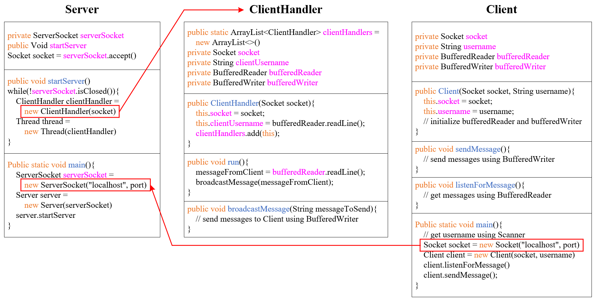
Framework of Project #1

Slide 6
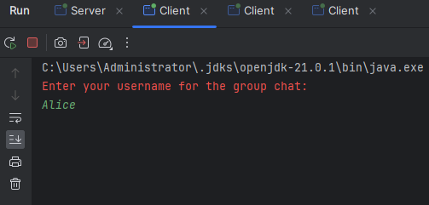
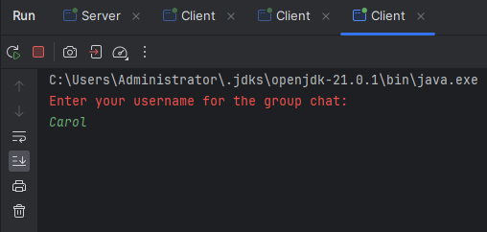
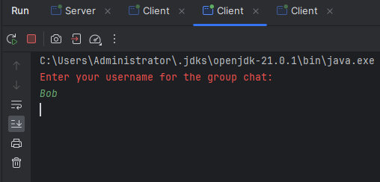
Sample Output
First, run the server.
Then input Alice, Bob, and Carol to three clients, respectively.

Slide 7
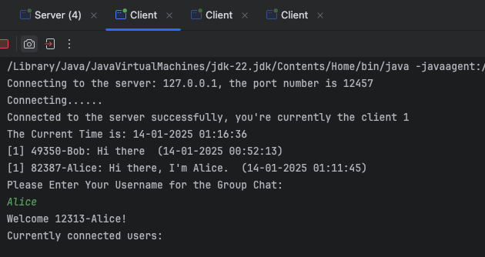
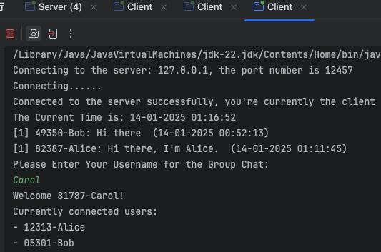
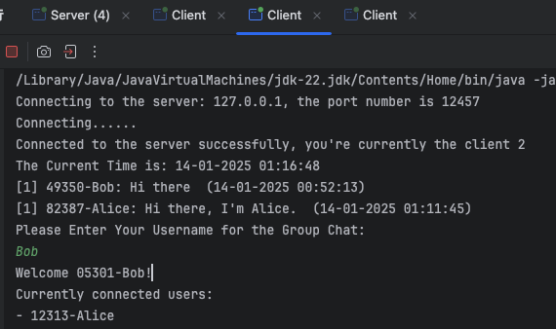
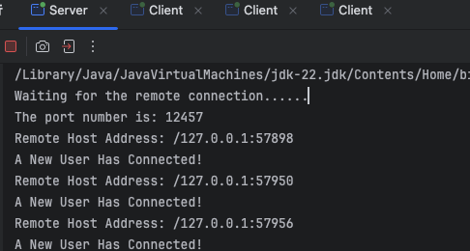
Sample Output

Slide 8
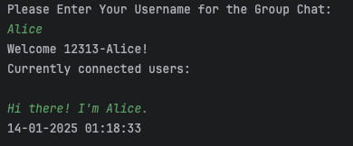
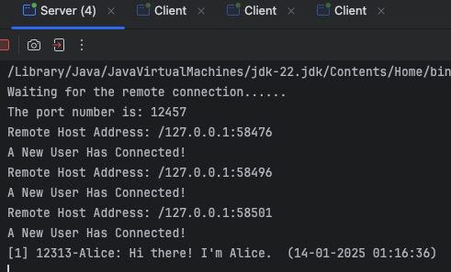
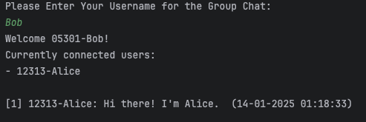
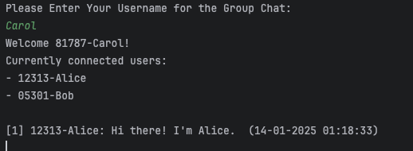
Sample Output

Slide 9
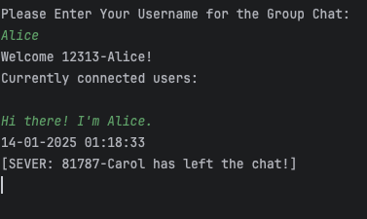
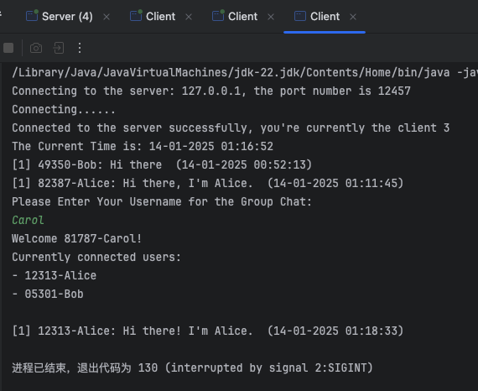
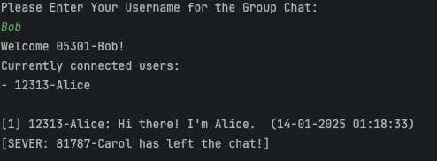
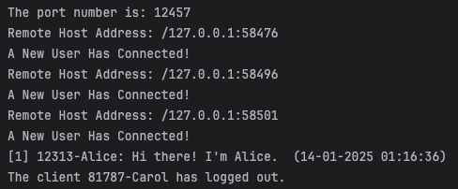
Sample Output

Slide 10

THANK YOU
林天麟 教授
香港中文大学（深圳）
机器人与人工智能实验室
WeChat: tinlunlam

